Slide 1
3D Fraud Defense – Business Plan
Tim Eastridge | July 2023

Slide 2

3D Fraud Defense - Introduction
Welcome to our Next Generation Fraud Prevention Platform, where cutting-edge technology meets the ever-evolving challenges of fraud detection and prevention.
We harness the power of advanced graph database technology to provide organizations with a robust and intuitive solution for combating complex fraud schemes.
Deep-analytics | Disruptive-technology | Data-driven
Notes:
Intro

Slide 3
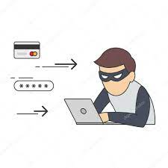
Market Problem
Fraudsters are becoming increasingly sophisticated, employing complex techniques that go beyond traditional detection methods.
Organizations struggle to keep up with emerging fraud types, leading to financial losses, reputational damage, and regulatory non-compliance.
There is a pressing need for a comprehensive fraud prevention solution that can address a wide range of fraud scenarios effectively.
Notes:
Intro

Slide 4
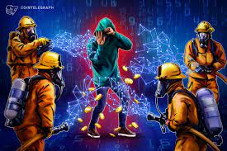
Our Solution
Introducing our next-generation fraud prevention platform powered by Neo4j, the leading graph database technology.
Our platform revolutionizes fraud detection by leveraging the strength of graph analytics and real-time transaction monitoring.
We provide organizations with the tools they need to capture and flag alerts, prioritize investigations, and stay one step ahead of fraudsters.
Isolating fraudsters with Graph Technology

Slide 5

How it Works (Part I): Advanced Alert Flagging
Our platform captures all alerts, including the most complex multi-connection money laundering techniques.
We employ advanced algorithms and machine learning to identify suspicious patterns, highlighting potential fraud in real-time.
Investigators can rely on our platform to help them sift through alerts efficiently and focus on the most critical cases.
Notes:
Intro

Slide 6
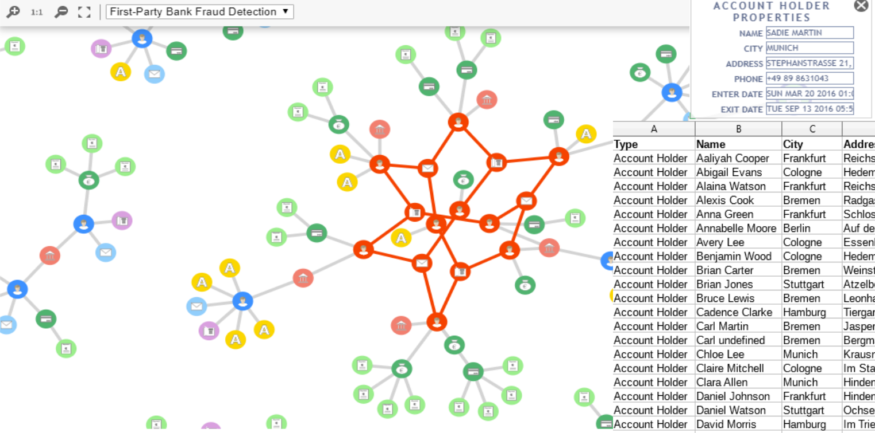
How it Works (Part II): Graph Visualization and GUI
Our platform offers a visually stunning and user-friendly Graphical User Interface (GUI).
Investigators can easily navigate and explore the interconnected relationships within the data, gaining valuable insights into fraud networks.
The intuitive visualization helps investigators uncover hidden connections and make informed decisions with confidence.
Notes:
Intro

Slide 7
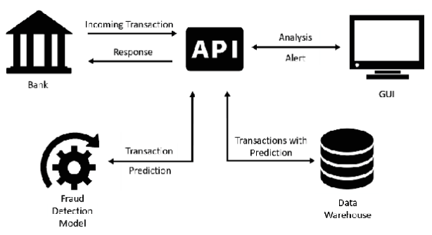
How it Works (Part III): Real-time Fraud Detection
Our platform utilizes REST APIs to provide highly efficient microservices for real-time fraud detection.
We continuously monitor transactions, analyzing vast amounts of data to identify and flag potentially fraudulent activities instantly.
By detecting complex fraud schemes such as credit card bust out fraud, we help organizations prevent significant financial losses.
Notes:
Intro

Slide 8

Security and Compliance
Security and compliance are at the core of our platform.
We adhere to industry-leading security standards, implementing robust data encryption and access controls to protect sensitive information.
Our platform assists organizations in meeting regulatory requirements for combating money laundering and countering terrorist financing.

Slide 9

Revenue Model
We offer flexible subscription-based licensing models tailored to our clients' needs.
Additional revenue streams include professional services for platform customization, integration, and ongoing support.
Our revenue model is designed to ensure scalability and long-term value for our clients.

Slide 10
Target Market and Competitive Advantage
Our target market includes financial institutions, government agencies, and organizations across various industries with fraud prevention needs.
Our competitive advantage lies in our innovative use of graph database technology, enabling comprehensive and efficient fraud detection.
We differentiate ourselves by offering a complete solution that covers all national priorities, addressing corruption, cybercrime, terrorism financing, fraud, and more.

Slide 11

Marketing and Sales Strategy
Our marketing strategy includes targeted campaigns aimed at raising awareness among key industry players.
We will forge strategic partnerships with financial institutions, regulatory bodies, and technology providers to expand our reach.
Our experienced sales team will build relationships with key stakeholders, providing tailored solutions to meet their fraud prevention requirements.

Slide 12

Growth Opportunities and Future Vision
We envision our platform becoming the go-to solution for fraud prevention, expanding globally and serving organizations of all sizes.
Opportunities for growth include expanding into new markets, developing advanced fraud prevention modules, and integrating emerging technologies.
We are committed to staying at the forefront of fraud prevention, continually evolving our platform to combat evolving fraud threats.

Slide 13


Social Impact and Compliance
Our platform plays a critical role in combating corruption, cybercrime, terrorism financing, and other illicit activities.
By assisting covered institutions in meeting regulatory obligations, we contribute to a safer and more secure financial ecosystem.
Our mission is to protect the integrity of financial systems and promote trust in the fight against fraud.

Slide 14
Team
No startup is successful without a strong, core team. Before embarking on this journey together, we must first nail down the team.
Tim (Founder and CEO with 60% Equity)
CTO (Contractor with 5-15% Equity)
Back-end Developer (Contractor with 1-2% Equity)
Front-end Developer (Contractor with 1-2% Equity)
Investor & Co-Founder (10-25% Equity based on Investment)
Technical Project Manager (Part-Time Consultant 0% equity ~$75/hour)

Slide 15
30-60-90 Day Development Plan
The initial round of funding would fuel team creation with the goal of generating a minimum viable product (MVP) to help refine the go-to-market strategy and next phase of development.
30 Day – Team Formation
Team formation Market Research and Validation | Prototype Development | Iterate on Business Plan
60 Day – User Feedback
Team Expansion | MVP Development | Initial User Acquisition Strategy | Early Feedback Collection
90 Day – Product Refinement
Targeted Marketing | Improve and Enhance the MVP | Prepare for Next Round of Funding

Slide 16
Investment Snapshot
Development of Front-end and Back-end
( 50% allocation)
Research and Innovation
(15% allocation)
Management, Business Development, and Strategic Planning
(35% allocation)

Slide 17

Join Us in Shaping the Future
Join us in revolutionizing the fight against fraud. Contact us today to learn more about our platform and how it can empower your organization to detect and prevent fraud effectively.
Email: [info@Eastridge-Analytics.com]
Phone: [(423) 502-0331]
Website: [www.Eastridge-Analytics.com]

